Slide 5
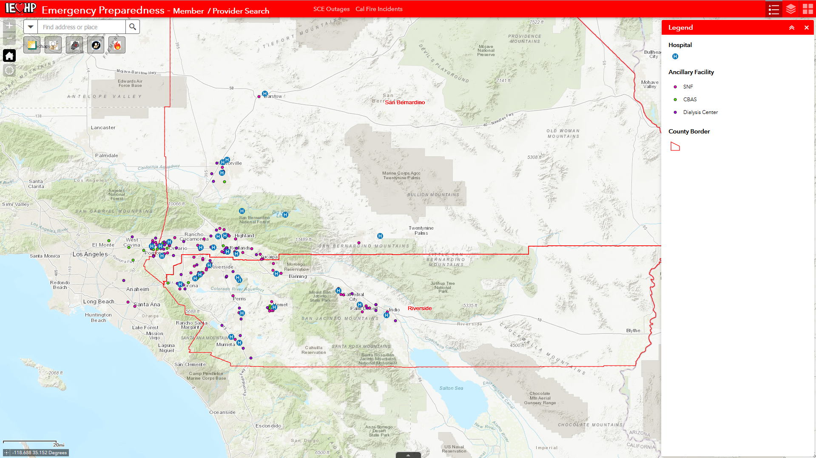
SCE Shut Offs Cal Fire Incidents
Notes:
Initially, the application shows the geographic extent of both counties along with contracted hospitals and Ancillary facilities (SNF, LTC, Dialysis Centers). All of the queries are located at the top left of the application.

Slide 6
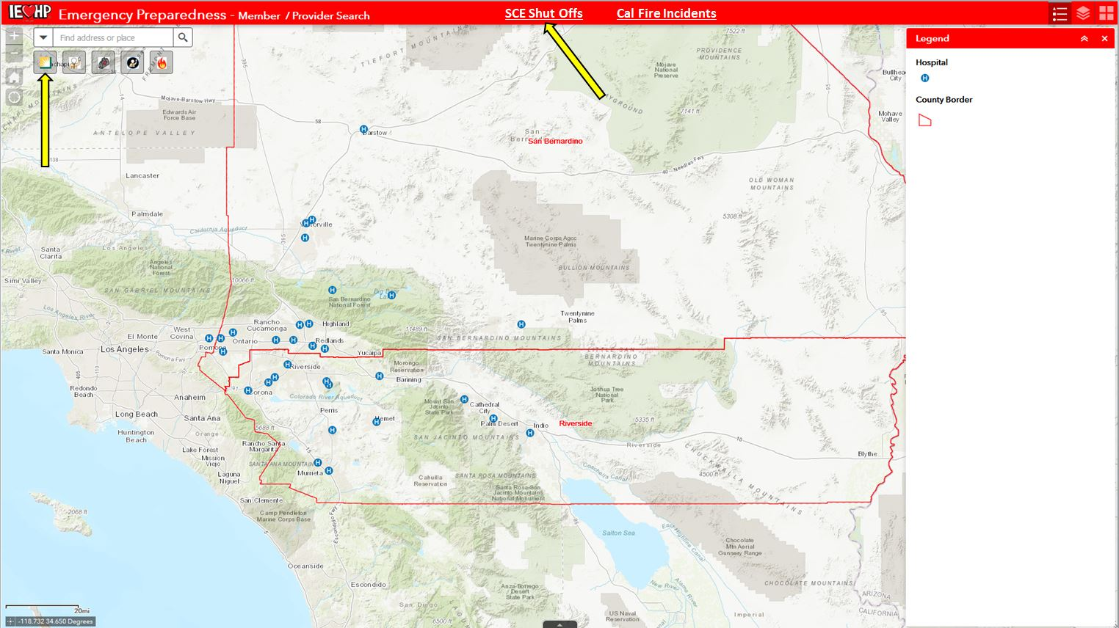
Notes:
Scenario #1: DME Members within Power Outage Area
All of the SCE Circuit Areas have been incorporated into the IEHP GIS. Circuit Areas that will lose power, also known as SCE Public Safety Power Shutoff areas (PSPS), are published daily on the SCE website and can be accessed via a hyperlink embedded within the application.

Slide 7
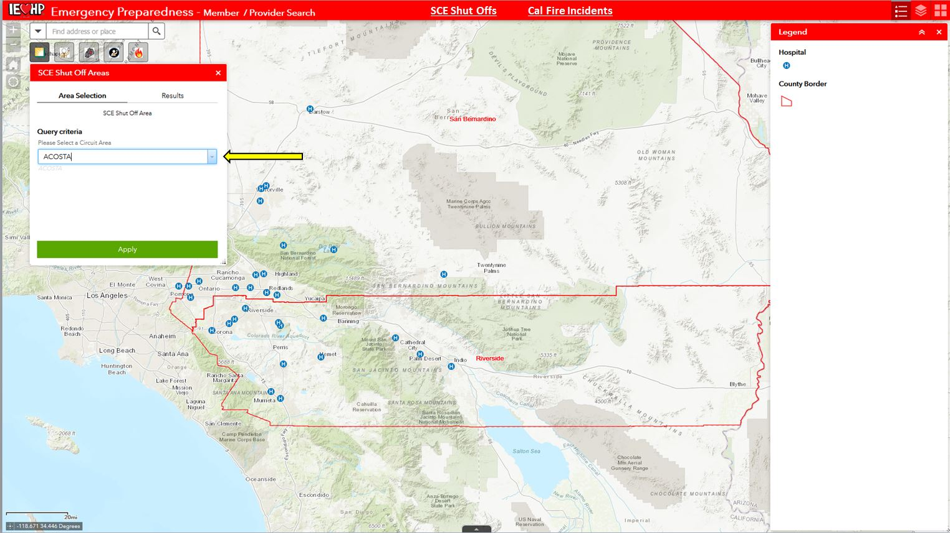
Notes:
PSPS areas can be queried and drawn in the application.
Example = “ACOSTA”

Slide 8
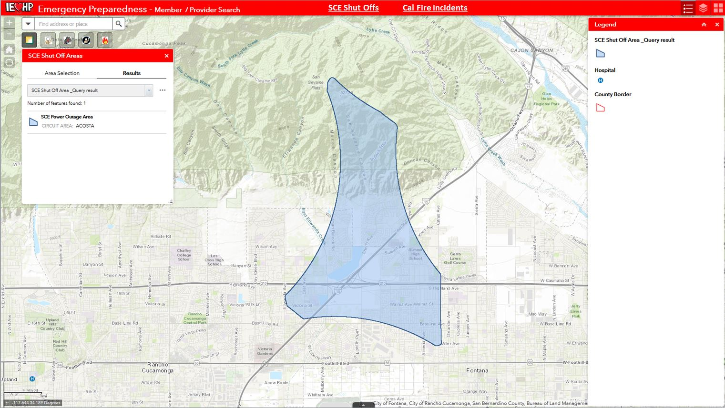

Slide 9
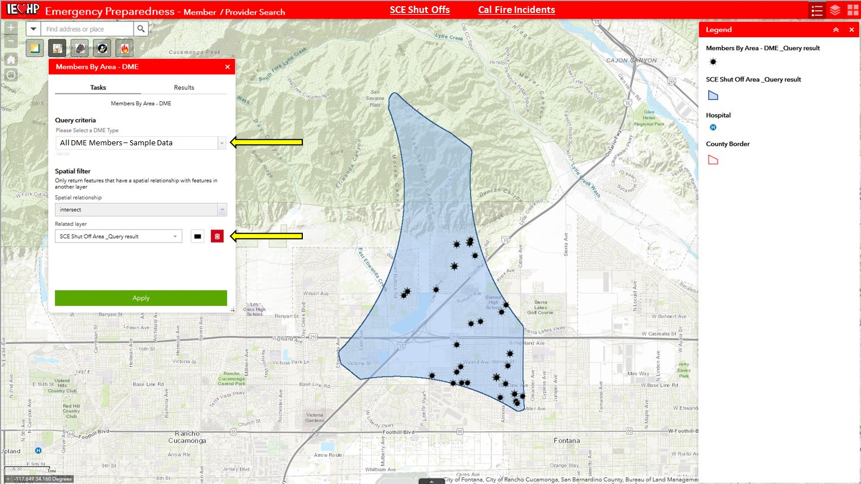
Notes:
Once the PSPS is created, it can be used to identify Members that reside within it that utilize a DME. The application user has the option to query all DME utilizers as well as only Membership based on a specific DME (Ventilator, Electric Hospital Bed, CPAP, etc.) .
The resulting list of Members can be exported in order to deploy an outreach campaign.

Slide 11
Notes:
Scenario #2: Identifying Full Membership , Providers, & Facilities Within a Wildfire Boundary
All wild fire activity is updated on the Cal Fire website and can be accessed via the embedded hyperlink.

Slide 12
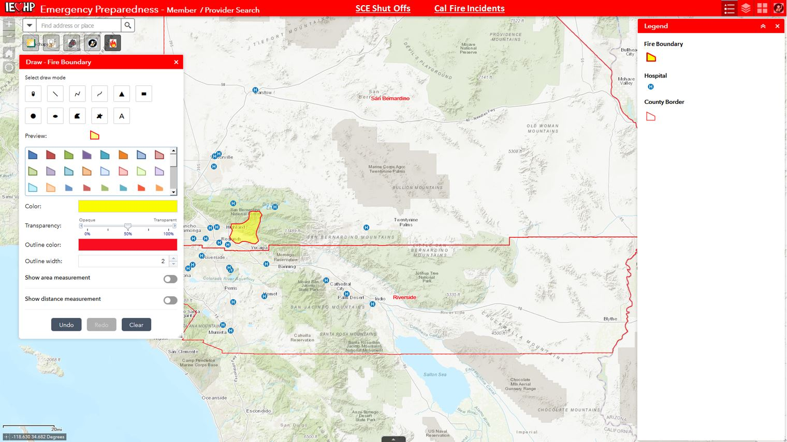
Notes:
Due to the fact that wildfires don’t follow a predetermined boundary, a “Draw” tool is utilized to allow the user to create an arbitrary boundary that is similar to those defined by Cal Fire.

Slide 13
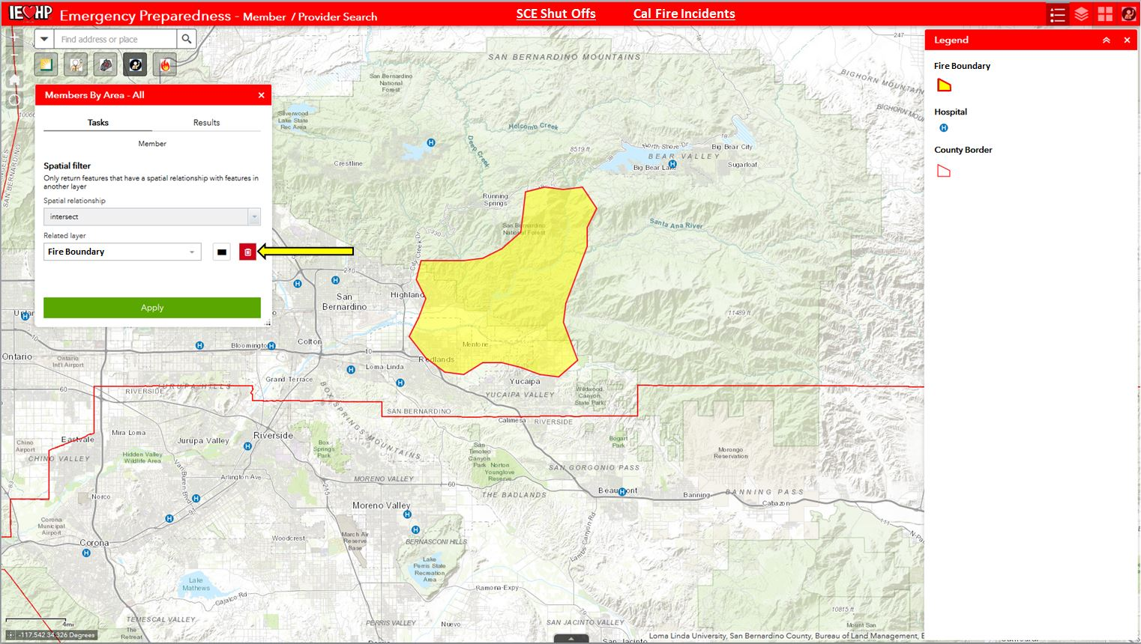
Notes:
Like the SCE convention, the fire boundary can be used to identify all of the Members that live within the affected area.

Slide 14
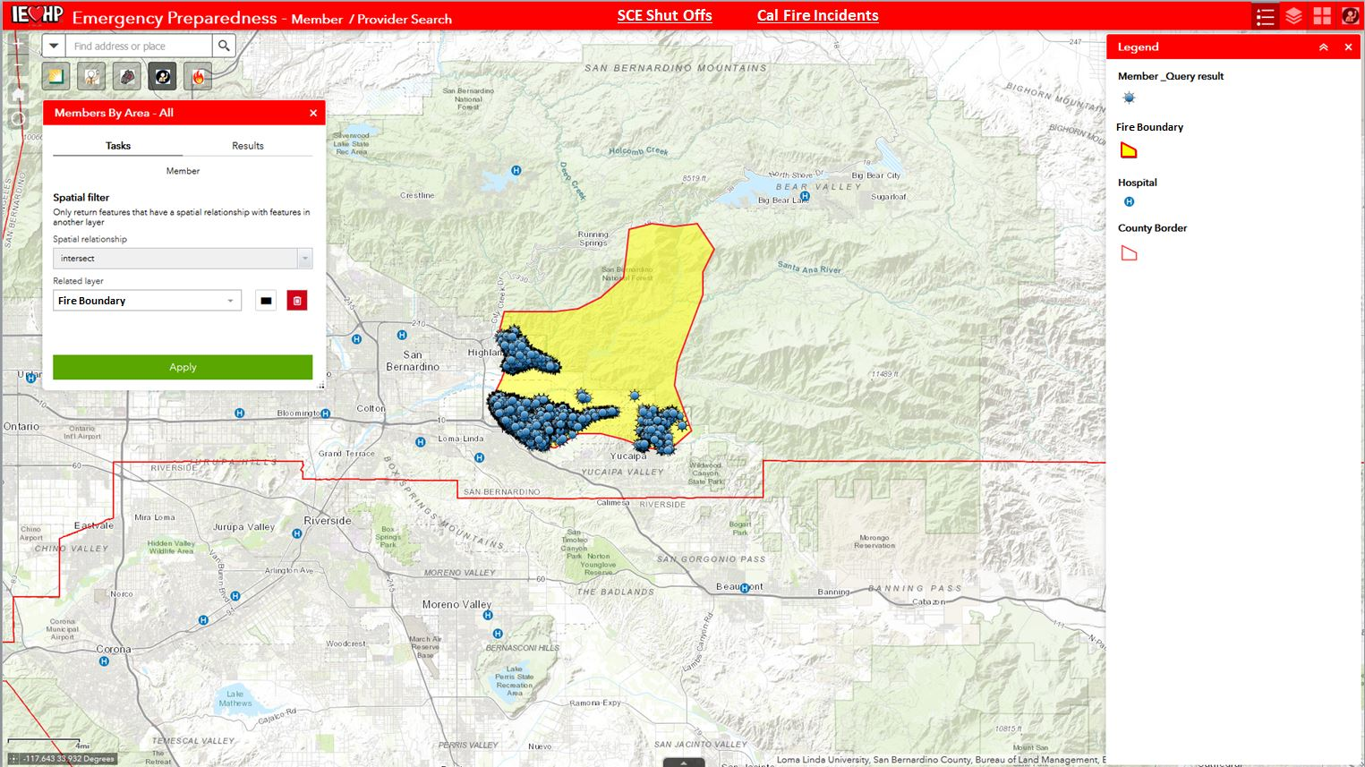
Notes:
Once again, the resulting list can be exported in order to deploy an outreach campaign.

Slide 15
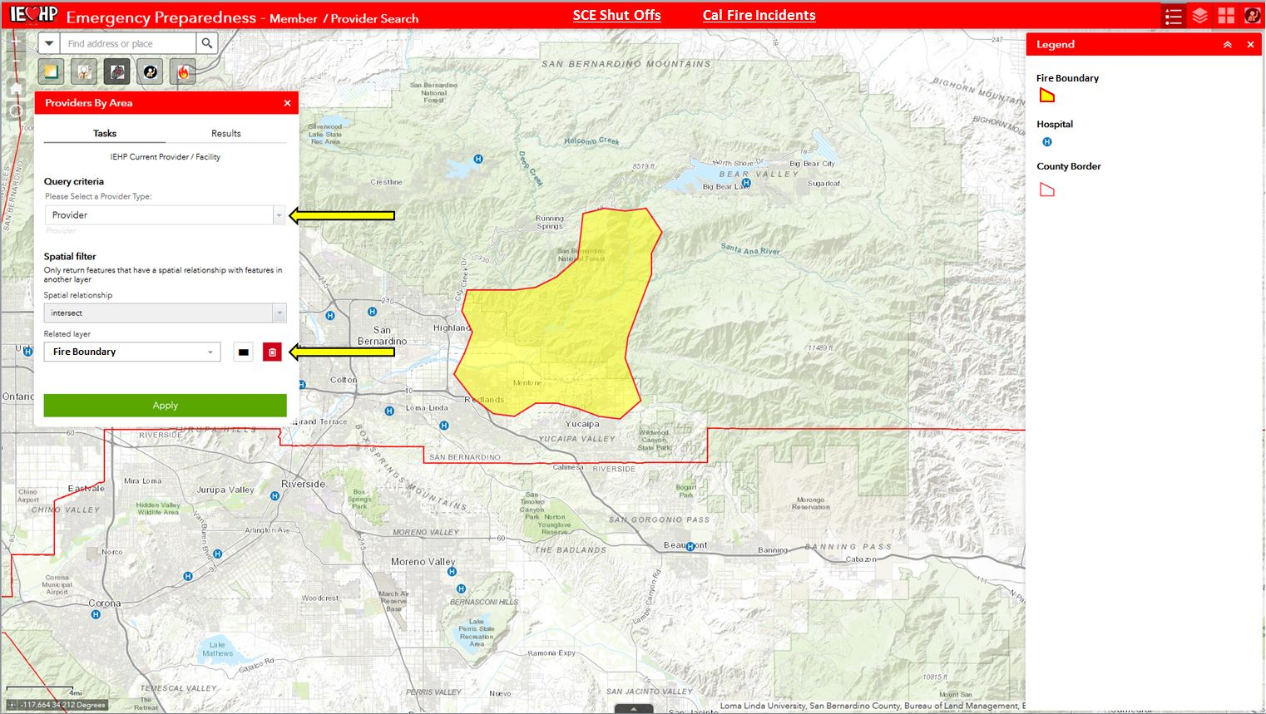
Notes:
Identifying Providers:
All IEHP Providers and contracted facilities are included in the web application and can also be identified. The user has the option to define a Provider / facility type in order to identify locations in the affected area.

Slide 16
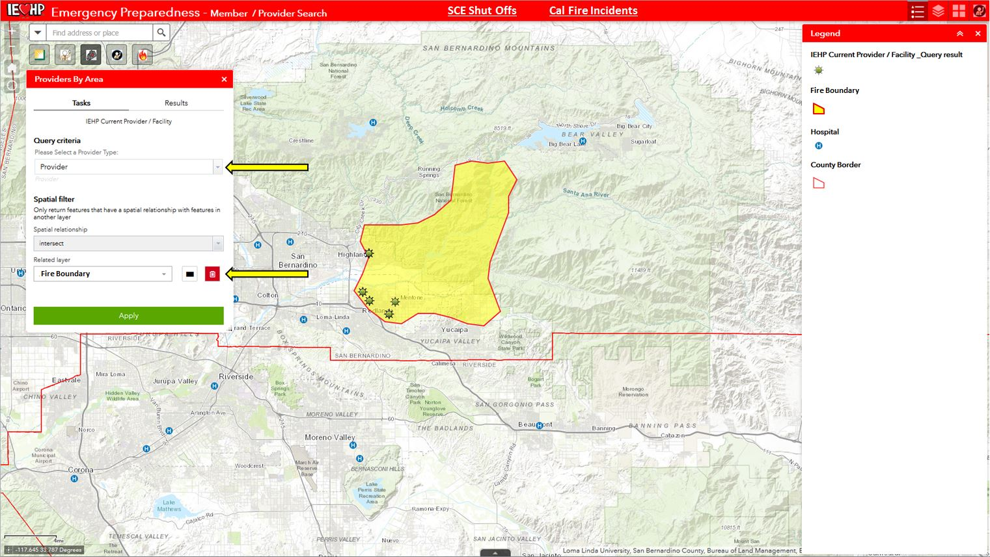

Slide 17
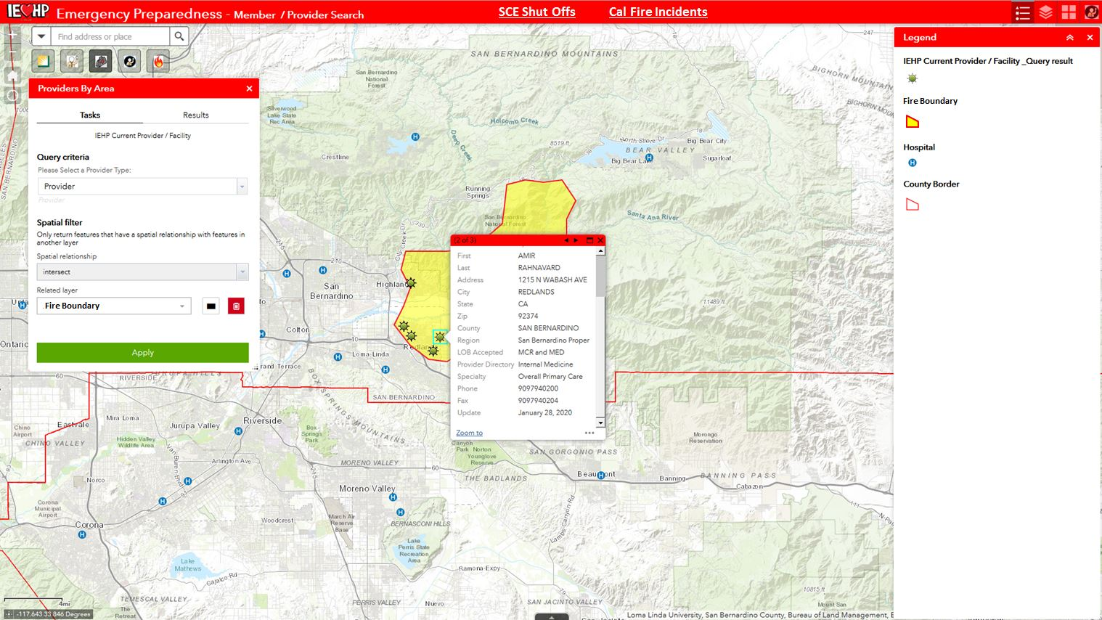
Notes:
A list can be exported or outreach can be done directly from the application by utilizing the available Provider information.

Slide 19
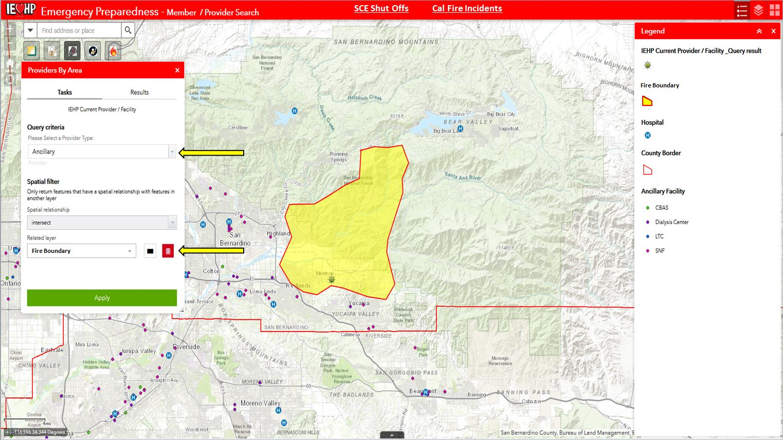
Notes:
Scenario #3: SNF Member Relocation
The web application also offers the ability to identify facilities around affected area so that strategies can be implemented to ensure Members / patient safety.
Example: A SNF falls within an evacuation area and Members need to be transferred to other facilities, the web application can assist the user by easily identifying nearby SNF’s that are located in a safer area .

Slide 20
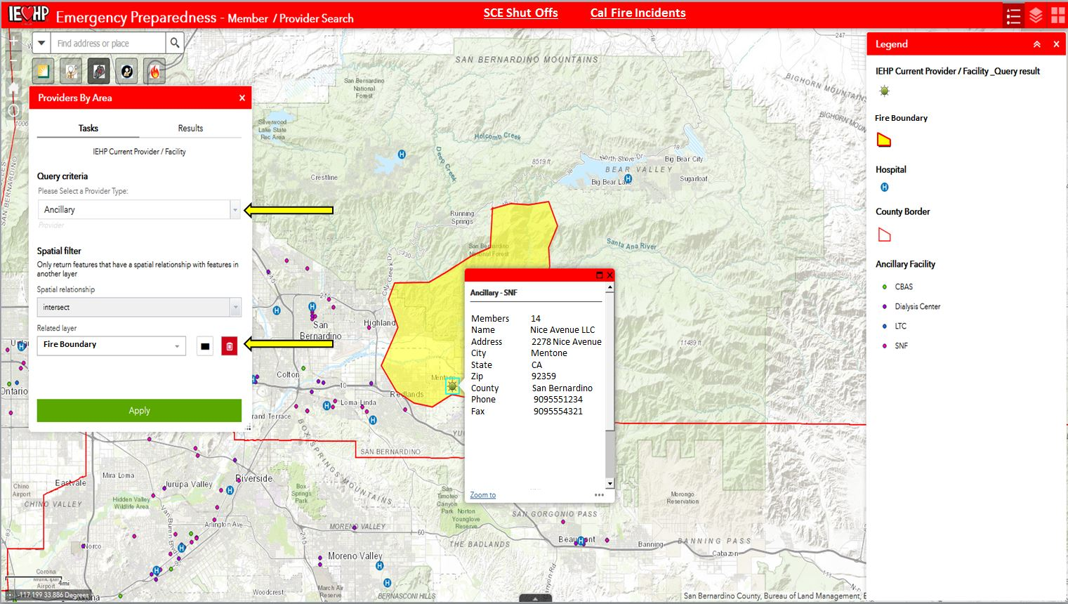
Notes:
The web application contains information such as facility name and phone number so the user can begin to outreach without having to leave the application.

Slide 21
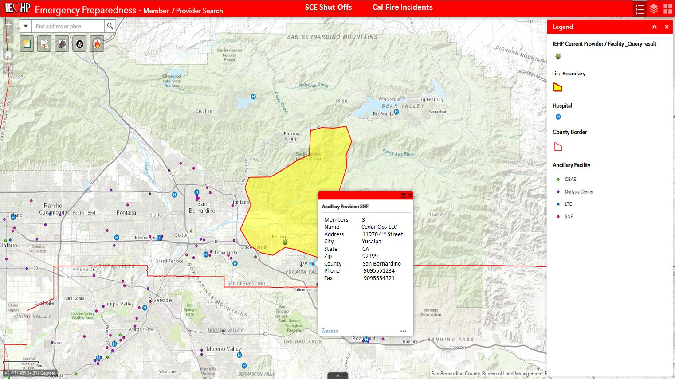
Notes:
Surrounding facilities can be contacted in order to coordinate the transfer of Membership.

