Slide 1
California Foundation for
Independent Living Center:
Disability Disaster Access & Resources
(DDAR)
Presenters: Christina Mills, CFILC
Dani Anderson, ILRC Santa Barbara
Eli Gelardin, Marin CIL

Slide 2
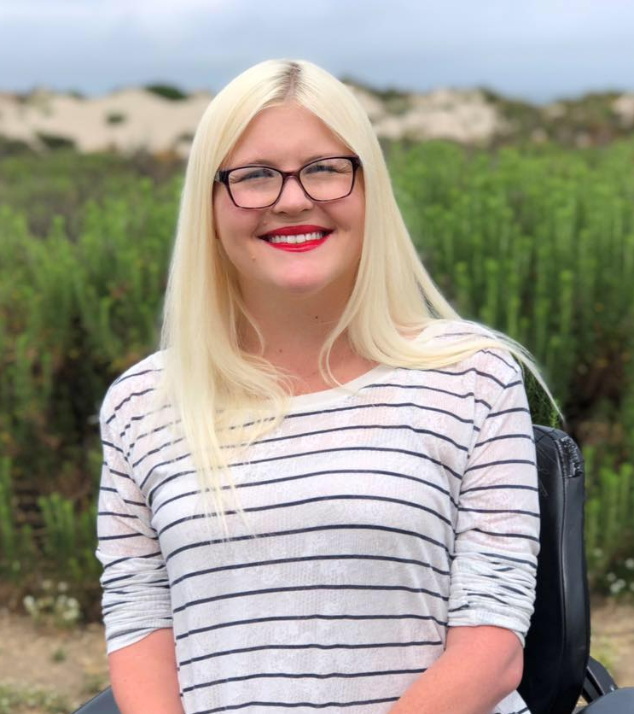
Webinar Speakers
Christina Mills
CFILC
Dani Anderson
ILRCSB
Eli Gelardin
Marin CIL

Slide 3
CFILC
CFILC is not an Independent Living Center we are a statewide membership association for Independent Living Centers
Independent Living Center (ILC) members make up CFILCs board of directors. Currently, CFILC’s membership covers 56 of California’s 58 counties.
CFILC membership directory, http://www.cfilc.org/members/meet-members.php

Slide 4
ILCs
Independent Living Centers are run by and for people with disabilities.
Independent Living Centers are disability resource centers that are uniquely positioned to provide peer based services.
There are 28 ILCs in California. 23 of the 28 ILCs are members of CFILC.

Slide 5
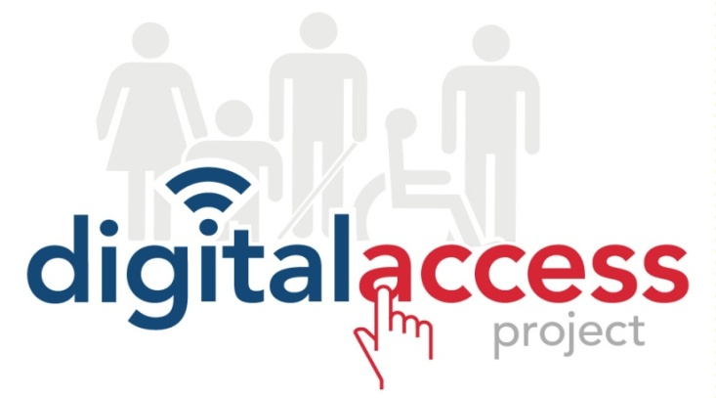
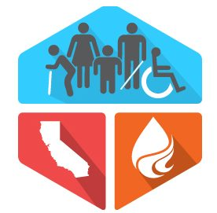
CFILC programs
Membership/
Public Policy

Slide 6
CFILC Disaster History
CFILC & ILCs:
Commissioned after action disaster reports
Sponsor, support and oppose disaster legislation
Provide expert witness testimony
Host and participate in disability disaster coalitions
Regional & local OES coordination and planning
Functional Assessment Service Team (FAST) members
Virtual and onsite shelter accessibility support
Fulfill/assist with AT and DME needs
Advisory committee and board representation
Established the Richard Devylder Disaster Relief Fund
Accessible Charging Stations at ILCs
Partnered with Anthem Blue Cross & Pacific Gas & Electricity

Slide 7
2019 Community Assessment

Slide 8
DDAR Pilot Program
CFILC Disability Disaster Access & Resources Public Safety Power Shutoff (PSPS)
Pilot Program – Launched in 2020
www.disabilitydisasteraccess.org

Slide 9
2019 PSPS support
Developed relationships with battery vendors
Small Sample Tests of AT/DME w/ Batteries
Received over 1000 incoming calls from individuals impacted
Provided 250 batteries to individuals
Assisted with over 82 hotels stays
Over 250 meals were provided
Assisted over 40 individuals with transportation/gas

Slide 10
2019 Lessons Learned
Every individuals situation is unique
Eligibility for PSPS resources need to be on a individual by individual basis
Batteries are a band aid
Educating and working with individuals to develop a long term sustainable disaster/PSPS plan is critical
Resources are limited and only reach so many individuals

Slide 11
What is a Pilot Program?
A small scale preliminary program or study that is conducted in order to evaluate feasibility, duration, cost, adverse events, and improve upon prior to performance of a full-scale program.
There is no program across the country that resembles what we are creating with DDAR.

Slide 12
DDAR Partners
All counties are covered by the pilot
except San Diego and Imperial
20 ILCs are engaged as local DDARC partners and working in collaboration with regional and local government , community organizations, utility companies, emergency personnel, community action networks & more

Slide 13
DDAR Target Audience
People with disabilities across the lifespan who utilized assistive technology and/or durable medical equipment on a regular basis
and therefore would be placed in
vulnerable positions without electricity.

Slide 14
2020 Pilot Program
A streamlined statewide structure with local expertise and peer-to-peer knowledge
Establishment of Disability Disaster Access & Resource Centers (DDARCs)
Prioritizing Tier 3 & Tier 2 High Threat Fire areas across the state
Public Awareness, Disaster Training, Medical Baseline and alert system enrollment

Slide 15
2020 Pilot Program Cont.
A peer-to-peer assessment to determine what an applicant might benefit from during an emergency, including a public safety power shutoff.
DDARC Resources: Motel/hotel and food assistance, transportation support and portable backup batteries.

Slide 16
Power Outages
Climate change continues to impact the reasons why we experience power outages.
There are different kinds of outages. The DDAR program at this point only provides resources to those who are impacted during a Public Safety Power Shutoff (PSPS).

Slide 17
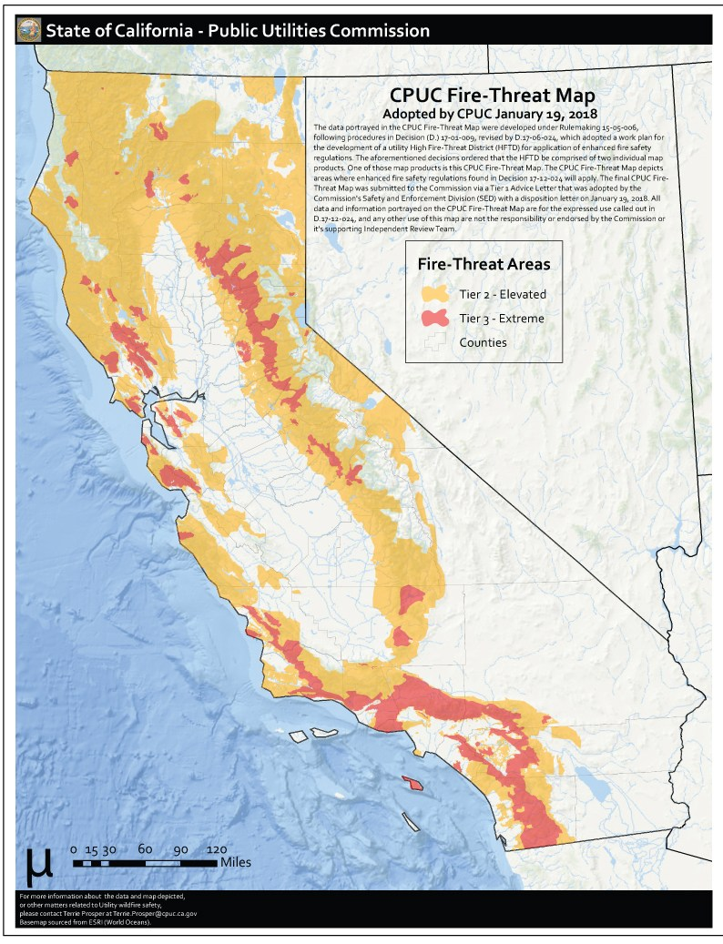
Most Vulnerable Counties
Tier 3
Alameda
Alpine
Amador
Butte
Calaveras
Contra Costa
El Dorado
Fresno
Humboldt
Kern Lake
Los Angeles
Madera
Marin
Mariposa
Medocino
Monterey
Napa
Nevada
Orange
Riverside
San Bernardino
San Diego
San Luis Obispo
San Mateo
Santa Barbara
Santa Cruz
Shasta
Sierra
Siskiyou
Sonoma
Tuolumne
Ventura
https://ia.cpuc.ca.gov/firemap/

Slide 18
DDAR Pilot Priorities
Keep people with disabilities safe and independent
Bust the Medical Baseline myths by increase the number of individuals enrolled in the program
Increase the individual preparedness among people with disabilities
Organize & facilitate emergency/disaster trainings and virtual community forums on emergency priority topics

Slide 19
DDAR Pilot Priorities Cont.
Provide support and resources to individuals with disabilities who use electric powered AT or DME devices before, during & after a PSPS events.
Host and participate in public awareness activities to educate the community on disaster/emergency impacts to people with disabilities.

Slide 20
How does it work?
Applying for PSPS Resources
Online application or Independent Living Center
Individualized Needs Assessment
Support in Enrolling in the Medical Baseline Program
Support in setting up a personalized disaster plan
Determining PSPS Resources Strategy
SAFETY & WELLNESS!

Slide 21
Local ILC DDARCs
Eli Gelardin, Marin CIL
Dani Anderson, ILRC Santa Barbara
Brief descriptions of what your programs look like based on your geographic areas.

Slide 22
DDAR Eligibility
Must use AT or DME on a regular basis
Must have a detailed personal preparedness plan or willing to create one with the support of local DDARC
Must be enrolled or willing to get enrolled in medical baseline program
Must live in a high fire threat area based on CPUC map

Slide 23
Questions & Comments:
Thank you!
Follow Us
Twitter - @_CFILC
Facebook - @CFILC.org
Instagram - @cfilc_1982

